Slide 1


Edtech Research
Low Level Overview

Slide 2

Table Of Contents
Introduction into EdTech Industry
Funding Landscape
Business Models
Market Risks
Impact on Education
Innovation and Trends
Conclusions
Sources

Slide 3

Intro to EdTech
Introduction to EdTech
In the wake of global challenges, EdTech has emerged as a transformative force, leveraging technology—hardware, software, and services—to reshape and enhance learning experiences. EdTech, or educational technology, represents the innovative fusion of digital tools and educational practices, revolutionizing traditional approaches to meet the demands of an ever-evolving world.

Slide 4
Intro to EdTech
Relevance of Edtech
2016 :Jio expansion lead to penetration of online modes in India
2019-2020:Covid -19 forced whole world to adopt online methods of business,eduation etc Online adaption increased significantly
China’s Edtech crash caused a ripple effect on India
Multiple Verticals in Online education came about
Covid-19 pushed the TAM to $6B
2020(US$74.2) to 2030(US$288.4B) Edtech Market Size

Slide 5

Funding Landscape
Funding Landscape
The funding landscape for EdTech in India has undergone significant transformations in recent years. Triggered by the expansion of Jio in 2016 and accelerated by the global pandemic in 2019-2020, the adoption of online education witnessed a remarkable surge. The COVID-19 impact propelled the Total Addressable Market (TAM) to $6 billion, projecting substantial growth from $74.2 million in 2020 to an anticipated $288.4 billion by 2030. Notably, this surge is driven by a multifaceted approach, incorporating various verticals in online education. The sector has attracted substantial attention and investments, becoming one of the most focused-upon segments in the Indian startup ecosystem.

Slide 6
Funding Landscape
Key Points
Competition and Right to Win:
Intense Market Competition: EdTech experiences fierce competition, with a multitude of startups entering various segments.
Key Differentiators: Establishing a clear "right to win" demands unique value propositions, superior user experiences, and staying at the forefront of technological advancements.
Impact of Capital Raises:
Double-Edged Growth: Substantial capital raises drive rapid expansion but contribute to market saturation and heightened competition.
Unicorn Strategies: EdTech unicorns pursue smaller players across sectors, leading to good exits for founders but often disappointing returns for investors.
Sustainability Challenge: Balancing growth and sustainability becomes crucial, necessitating thoughtful consideration of the long-term implications of capital raises.

Slide 7

Business Models in EdTech
Business Model:Acing an entrance exam? Getting a job? Finding new mentors? Because the goal of the consumer will determine how much and where they will pay, how they will discover the platform, and how they will behave.
Self Made Markets: Most market sizing reports in the past have underestimated the edtech TAM for one simple reason: a good product creates its own market.
Catalysts of Education: Businesses that are not directly engaged in teaching (or not directly engaged in imparting learning) but are servicing the overall education sector, have been seen as catalysts

Slide 8
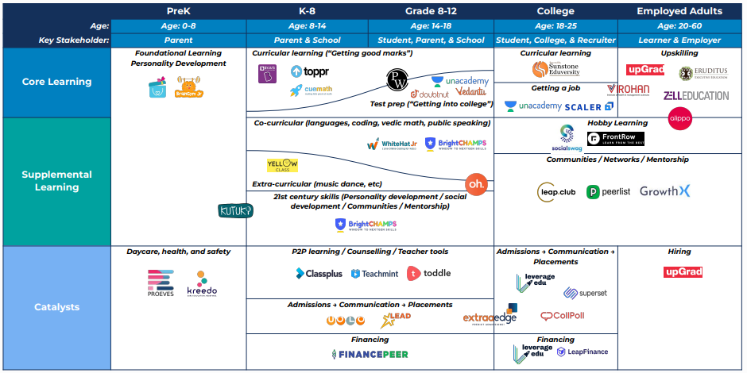
Business Models
Business Space

Slide 9
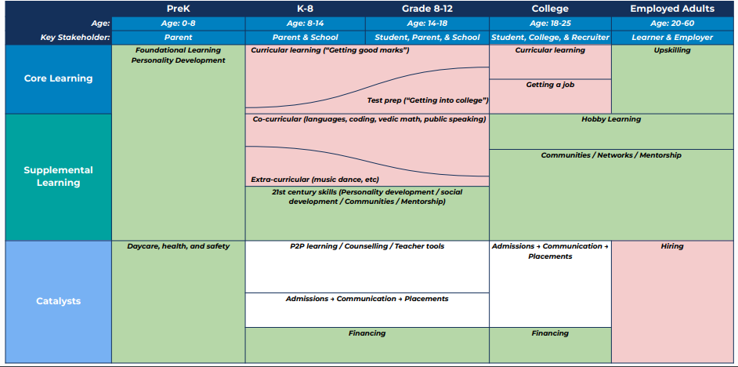
Business Models
Market Crowd

Slide 10
Market Risks
Market Risks & Challenges
Chinas EdTech crash was primarly due to inproportionate pricing even in India Byju’s, which was valued at $22 billion during its most recent fundraising round in October 2022, has experienced a substantial decline to a current valuation of $3B causes of this is primalry the emergence of EdTech giants with a good product market fit
Now what defines a product market fit best example will be the Physics Wallah which has become the first company from Ed-Tech space to become a unicorn in 2022 because the vision of PW was to provide education at the lowest price so that every student can study and achieve their dreams
Which is just about the right kind of product for the Indian audience

Slide 11

Market Risks
Challenges Faced By Edtech Startups since 2020
High CAGR and Low Retentions
Trust is Hard to Gain
Offline coming back
Crowded Market
Locked up Cap tabel
Tough Talent Market

Slide 12

Impact onEducation
Impact on Traditional Education
Paradigm Shift in Education:
Digital Transformation: EdTech catalyzes a fundamental shift from traditional to digital learning methodologies.
Adoption Acceleration: Rapid adoption of online platforms, redefining the way students access and engage with educational content.
User Adoption Trends:
Exponential Growth: Significant increase in user adoption rates, reflecting the widespread embrace of EdTech solutions.
Diverse User Base: EdTech attracts users across demographics, from K-12 students to adult learners seeking continuous education.
Educational Methodology Evolution:
Personalized Learning: EdTech fosters personalized learning experiences tailored to individual student needs.
Innovative Pedagogies: Emergence of innovative teaching methodologies, integrating technology to enhance engagement and comprehension.

Slide 13
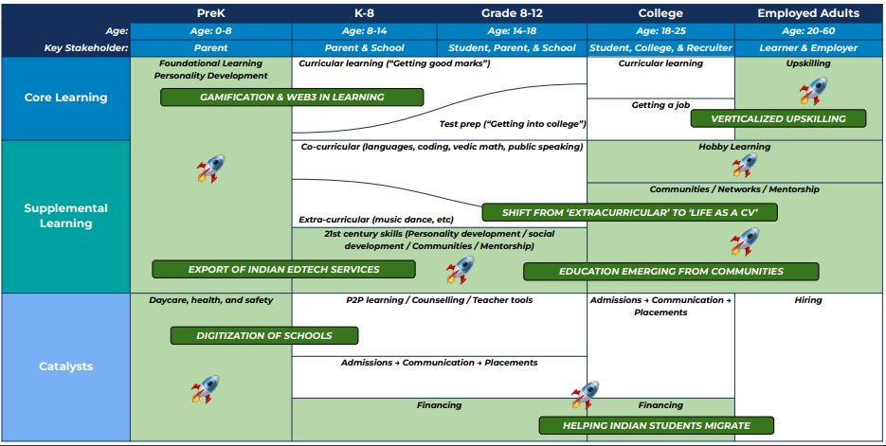
Trends
Innovation and Trends

Slide 14
Business Breakdown
PreK Under age 8 : Learning , Personal development and preschooling and daycare
K12 :21 century skills,College&Financing
New graduates and working adults :Upskilling ,Communnity building and mentorships
These are 3 different customer markets these EdTech companies operate on and fundamentally everything from purchase decisions to marketing statergies differ significantly across these bard categories and each of has a huge market size to be captured

Slide 15

Conclusions
Conclusion
EdTech arena is a dynamic frontier, reshaping how we approach education. Picture this: traditional learning underwent a tech metamorphosis, and the impact is seismic. Fast-tracked by the urgency of COVID, classrooms have seamlessly transformed to reside within our pockets. The pulse of EdTech is in sync with the rhythm of innovation, where competition is robust, funding endeavors are strategic, and adaptability is key. In this digital journey, the mantra is clear – it's not just about the size of the investment, but the smart utilization of resources.

Slide 16

Sources
Blumberg EdTech Report :https://blume.vc/reports/sector:edtech
Tracxn::https://tracxn.com/d/sectors/edtech/__fPwPVORWpMV0ZBc8pzbBQuRHbHgOhpGTjddL4QIjHg8
Blumbergs EdTech Report has a comprehensive view of the EdTech Industry and most of this report is based on the valuable information got from refering to Blumberg Report Additionally i cross checked with different sources to build the report .Bluemberg Report offers the most amount of insights and its a free resouces

Slide 17

Thank You For Your Attention
Thomas Antony
ph:6282076096,8547854537
Gmail:thomasantony14@gmail.com

